Slide 1

Project name: Online Retail
By: Group-12

Slide 2
TEAM INTRODUCTION
Milan Kiranbhai Patel
Ritik Bharatbhai Patel

Slide 3

BACKGROUND
Because of increasing popularity of online shopping, it is important to understand how consumers are making purchasing decisions and how online retailers can improve their business strategies to attract and retain customers.
To remain competitive in the online retail market, businesses must have a solid understanding of their target market and consumer behavior.
This has led to an increased need for retailers to understand how their customers are making purchasing decisions and what factors influence those decisions.

Slide 4
PROBLEM STATEMENT
By conducting a gap analysis, online retailers can gain insights into the areas where they need to focus their efforts to improve their operations and drive growth.
By conducting gap analysis on the Online Retail dataset, online retailers can gain valuable insights into their operations, such as their sales performance, customer behavior, and inventory management.
This information can be used to identify areas where improvements are needed and to develop strategies to bridge those gaps.

Slide 5
To gain insights into the performance of their online retail operations, identify areas for improvement, and make more informed decisions.
By gaining insights through gap analysis, online retailers can also better understand trends in their business and the wider market.
Audience:
Retailers: By analysing the sales data, the retailer can identify trends and opportunities for growth, which can lead to increased sales.
Customers: Through the analysis, customers can identify popular items, least favorite items, and their corresponding sales figures.

Slide 6
PROJECT PROPOSAL
The online retail dataset can be a valuable resource for businesses and researchers to gain insights into customer behaviour and e-commerce trends, and to develop strategies to improve their operations and drive sales.
First, we clean the data from the dataset. For analysis, we remove negative values and unhelpful information from the dataset. Then, we create a descriptive analysis for sales trends and popular products.
We will help online retailers to better understand their operations, identify areas for improvement, and make informed decisions to optimize their operations and achieve their business goals.

Slide 7
ANALYSIS QUESTIONS

Slide 8
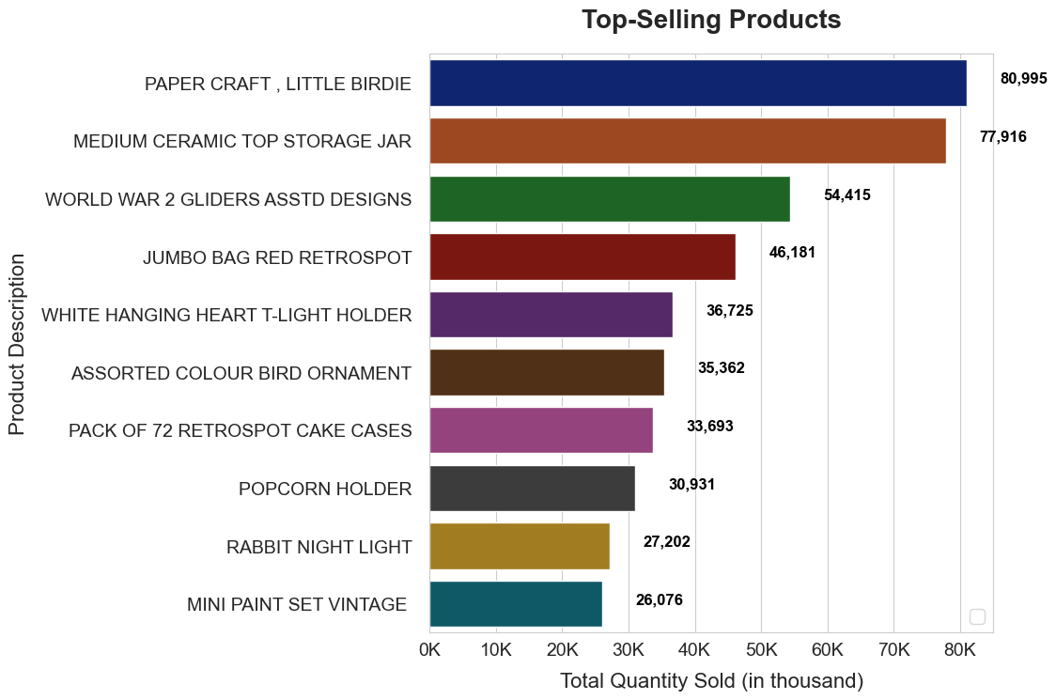
1. What is the top-selling product?

Slide 9
DESCRIPTION
As per plot, we can see that on the x-axis, we have total quantity sold (in thousand) and on y-axis, we have the products.
From the plot we can say that top-selling product is the "Paper Craft, Little Birdie" with 80,995 units sold. The second best-selling product is the "Medium Ceramic Top Storage Jar" with 78,033 units sold.
The next three products are the "World War 2 Gliders Asstd Designs," "Jumbo Bag Red Retrospot," and "White Hanging Heart T-Light Holder," with sales figures of 55,047, 48,478, and 37,895 units, respectively.

Slide 10
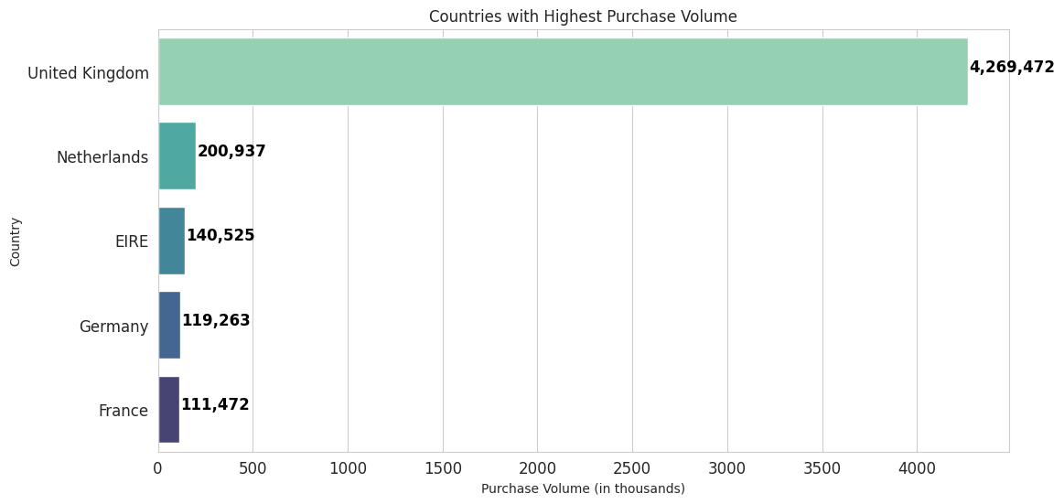
2. Which countries have the highest purchase volume?

Slide 11
DESCRIPTION
We can see that on the x-axis, we have total quantity sold (in thousand) and on y-axis, we have the products.
As per plot, Untied Kingdome have the highest sales volume and France have least sales volume.

Slide 12
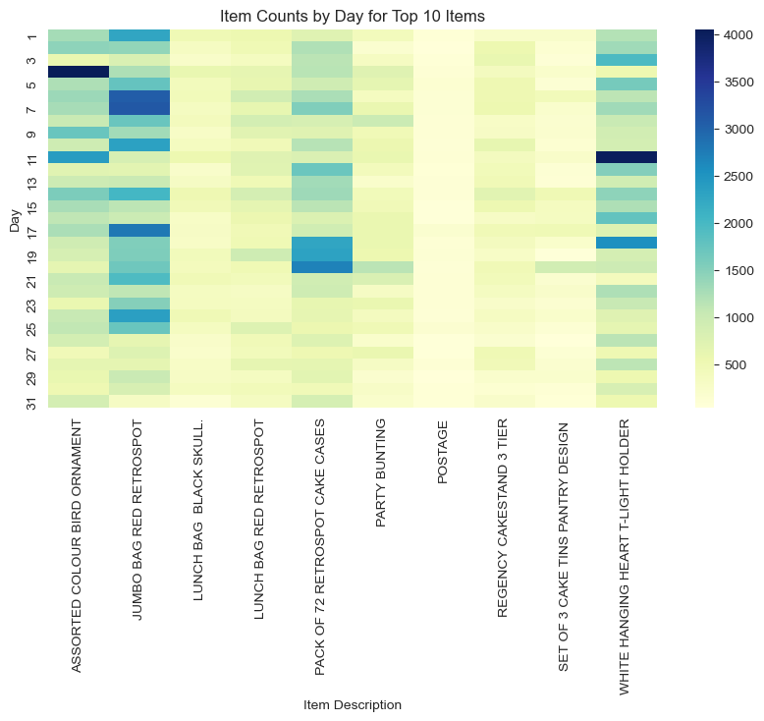
3. Are there any relation between the purchase of certain products and throughout the month.?

Slide 13
DESCRIPTION
This code is creating a heatmap visualization using Seaborn and Matplotlib libraries to display the item counts by day for the top 10 most frequent items in a retail dataset.
It first extracts the top 10 items with the highest frequency count, then filters the data to include only these top 10 items. It pivots the data to create a table of item counts by day.
It has been observed that two items, JUMBO BAG RED RETROSPOT and WHITE HANGING HEART T-LIGHT HOLDER, sell more throughout the month.

Slide 14
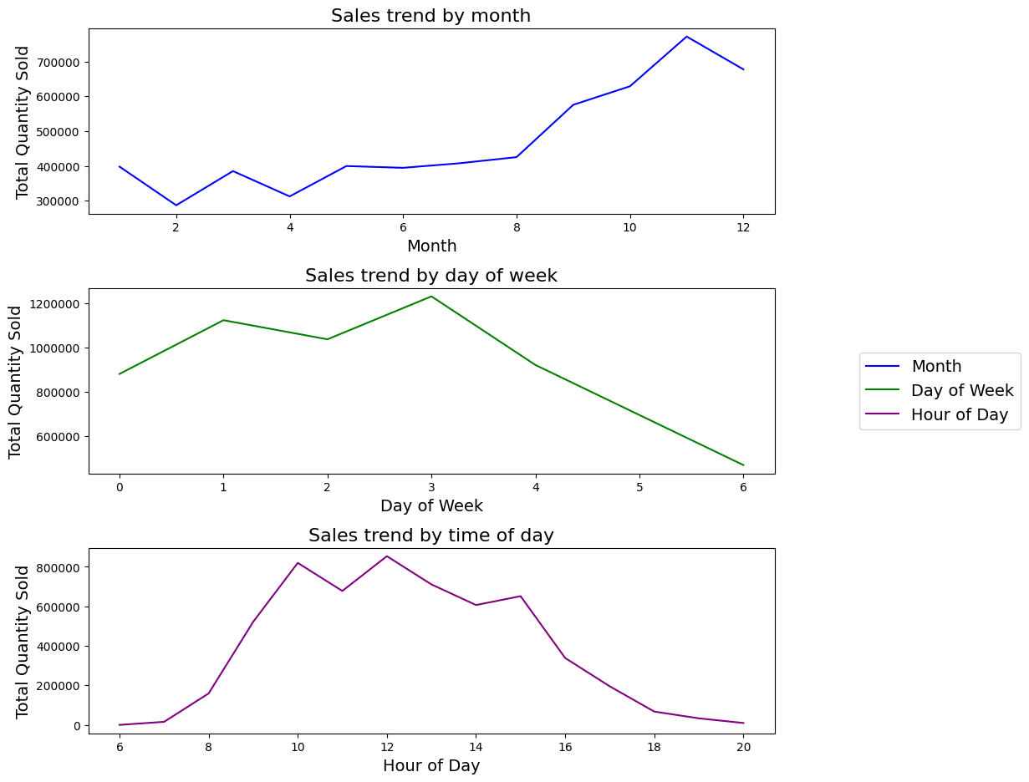
4. What are the sales trends by month, day of week, and time of day?

Slide 15
DESCRIPTION
It extracts month, day, and time information from the "InvoiceDate" column and creates three line charts to show the sales trend by month, day of the week, and time of day.
These charts are displayed in a single figure with three subplots, and the y-axis represents the total quantity sold.
In the sales trend by month, it can be observed that sales have been trending upwards during the last quarter. In the sales trend by day of the week, sales tend to gradually decline after Wednesday. In the sales trend by time of day, the highest quantity of products were sold between 8am to 2pm.

Slide 16
DATASET DESCRIPTION
Dataset Link: https://data.world/uci/online-retail.
The dataset is based on online retail transactions of a UK-based retailer.
The dataset included data on online retail transactions from 01/12/2010 to 09/12/2011. It has based on invoice no, description, quantity, and many other key points.

Slide 17
LINKS
GitHub: https://github.com/MilanKPatel/DAB103Group12
Jira: https://milanpatel.atlassian.net/jira/software/projects/DAB/boards/1

Slide 18
Thank You

